Slide 1
Why do people leave our Telecom provider?
Reem Sowayed
Mohamed Abduljalil
Husain Albinkhalil

Slide 2
Telecom Satisfaction Survey
“I was offered a better deal by a new provider”
8,000 respondents
Customers who aren’t satisfied with the telecom service they receive, revealing that half of them switched providers
Four in ten of those who had switched providers say they found a better deal elsewhere
“I experienced poor customer service”
“There were connection problems”
18% of switchers moved providers after experiencing poor customer service
Connection problems drove away 14% of respondents away

Slide 3
Customer Service Essentials
Adequate Response Time
Providing Clear and Accurate Updates on the Status of Requests
Complaint
Resolution
Quality of Customer Service Staff

Slide 4
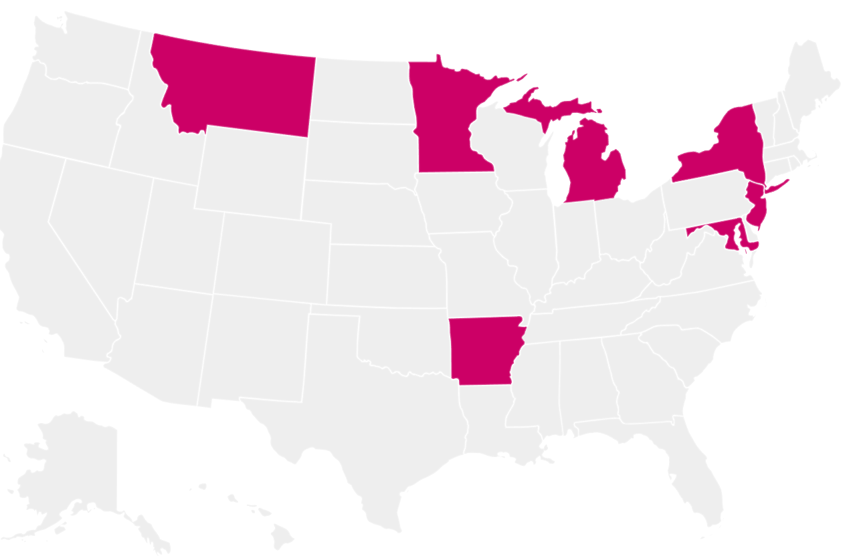
Geographical Trends in Customer Service Calls
Why? Service quality within these regions
Concentration in the north & northeast = geographical pattern

Slide 5
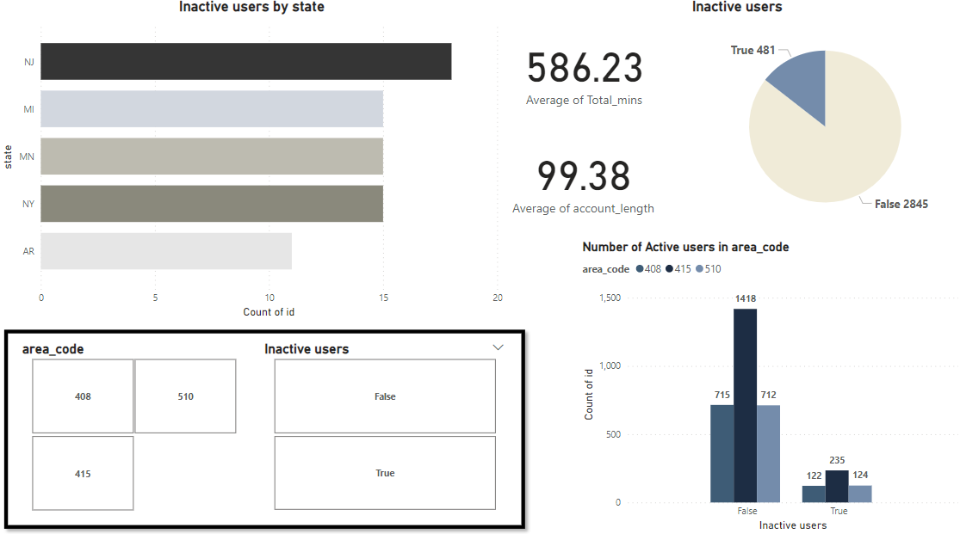
Exploratory Data Analysis

Slide 6
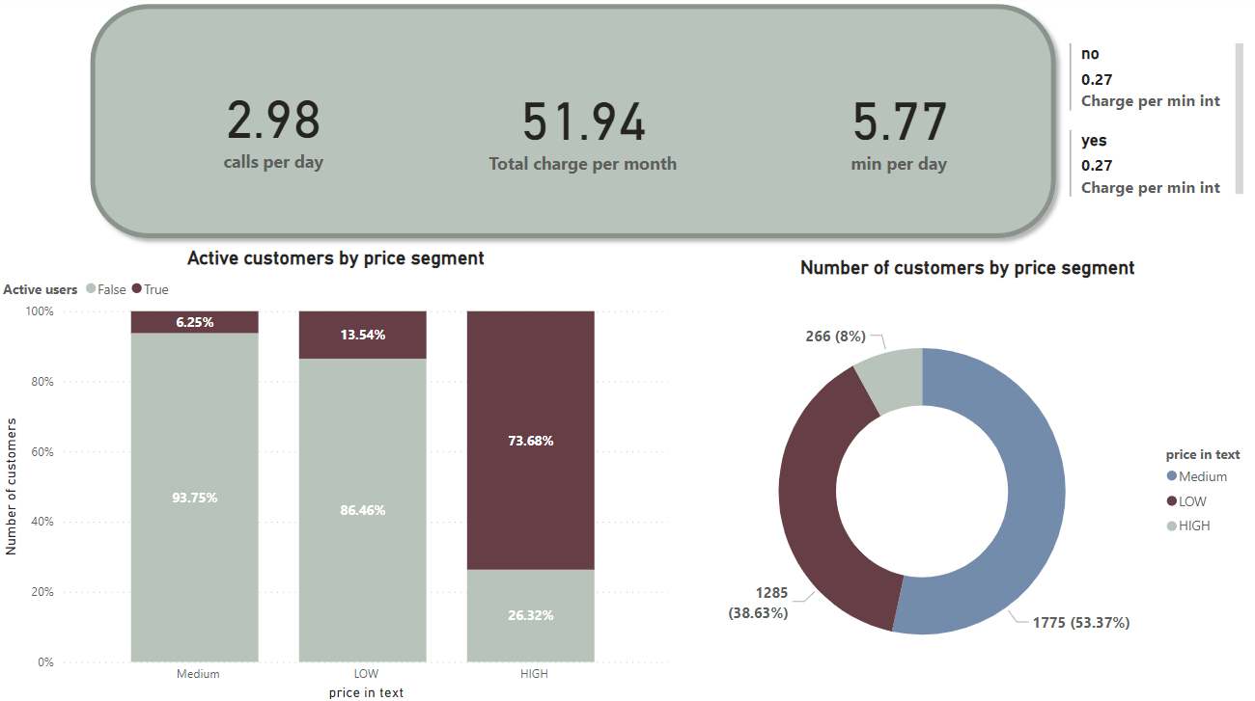
Monthly Plans

Slide 7
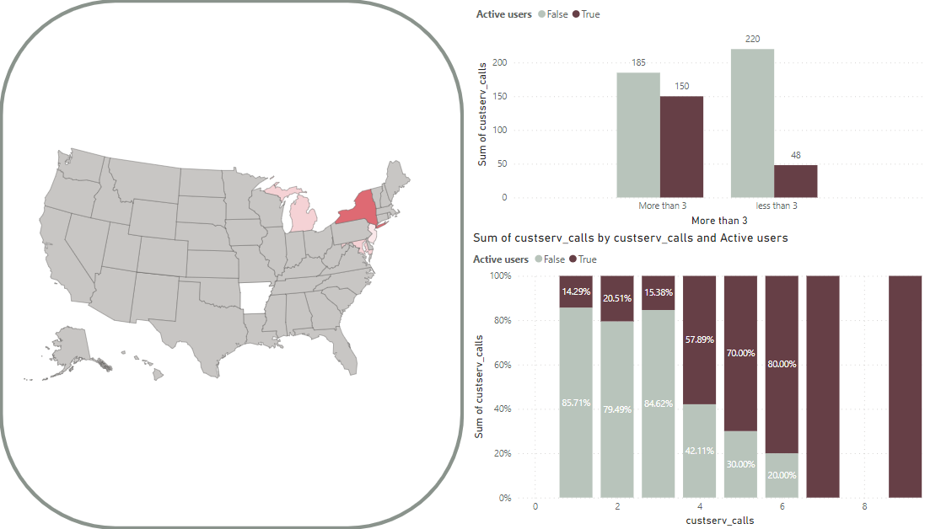
Customer service

Slide 8
Comparison with other competitors
Company | Line Package ($) | Coverage | Package Details | Promotion
XYZ | AVG $51.9 | - | charges by calls per usage | N/A
AT&T | $35.99 | 5G | Unlimited talk, text & data | Free Access for SD quality stream
T- Mobile | $41,5 | 4G LTE | 20 GB Unlimited Calls | Streaming Services Charged $10

Slide 9
Challenges
Customers Billing Cycle
Network Coverage & Quality
Customer Service Quality
Packages Pricing
Poor customer service quality
High prices with no features/promotions
Subscribed/unsubscribed customers to voice/international plans receives the same billing amount
Poor network / coverage
01
02
03
04

Slide 10
Recommendations
Attracting and retaining customers
Exceptional Customer Service
Competitive Packages Pricing
Provide excellent customer service through multiple channels. Resolve issues promptly and professionally
Provide competitive pricing plans so customers are more inclined to stay
Promotions and Discounts
Quality Network
Use promotions, discounts, or special offers to attract new customers and keep current ones
Ensure whole areas are covered with an excellent network, reliable and high-quality services
Loyalty Programs
Customer Retention Analysis
Utilize analytics to identify the patterns and potential churn indicators. address issues to prevent customer dissatisfaction
Implement loyalty programs with rewards for long-term customers. Offer exclusive deals, discounts, or early access to new services

